Slide 1
People v. Michael Burgund
A Case Study (2011 – 2018)
Detective Sergeant Michael O’Neill, Alton Police Department
First Assistant State’s Attorney Crystal Uhe, Madison County State’s Attorney’s Office

Slide 2
GUY WALKS INTO A POLICE DEPARTMENT….
April 4, 2011

Slide 3
FAMILY LIVING THE DREAM
FATHER - MICHAEL BURGUND 28
MOTHER – MELISSA BURGUND 29
DAUGHTER – M B 3
DAUGHTER – K B 2

Slide 4
Life
Married 5 years
Regularly attend River of Life Church
Michael works full time
Well thought of in community
First lived at Melissa’s parents house 2007-2009
Rented their own apartment 2009 - 2010
Bought their first home 2010 (Aberdeen St)

Slide 5
Other Family
Michael’s parents:
Donna and Steve Burgund
Melissa’s parents:
Mary and Ken Buttry

Slide 6
THE STORY BEGINS:
FIRST DISCLOSURE
Around 2009 M B points to her sex organ and says ”dada” to Melissa’s mom Mary (“mumga”)
Mary mentions this to Melissa and Michael – both deny anything going on

Slide 7
SECOND DISCLOSURE
2-3 MONTHS PRIOR TO REPORT
M B modeling princess gown in front of family and Mary notices how Michael was looking at M B
M B later tells Mary “Its all my fault” “I will never see my family again”

Slide 8
SECOND DISCLOSURE
2-3 MONTHS PRIOR TO REPORT
Mary talks to M B about good and bad touches – M B denies
M B then tells Mary, Michael touched her and points all over her body including sex organ
Mary tells M B if he ever touches her there again to tell him she told her (Mary)

Slide 9
THIRD DISCLOSURE
Shortly after, M B tells Mary her dad is sorry and he will never do it again
M B says he told her not tell anyone or he would be in big trouble

Slide 10
CONFRONT MICHAEL 2nd time
March 30, 2011
Mary tells Melissa what M B had said
M B confirms to Melissa that Michael touched her (M B points to her mouth, sex organ, and buttocks)
Melissa and Mary separately confront Michael with the information
Michael returns with weak denials and excuses
Children stay with Mary and Ken Buttry (family doesn’t know what to believe)

Slide 11
April 1, 2011
Decision is made that Children need to be at their own home.
Michael goes to stay with Mary and Ken Buttry

Slide 12
MICHAEL’S 1^{ST/ 2ND} ADMISSION
April 2, 2011
Michael tells Mary and Ken that he had touched M B and K B inappropriately
“I would have told you the whole thing earlier but I knew I’d go to prison”
Michael calls Melissa and admits to her several sexual acts.
M B begins to disclose more details to Melissa

Slide 13
MICHAEL’S 3RD ADMISSION
April 3, 2011
Mary and Ken Buttry go to talk to the pastor Mark Church at River of Life Family Church
Michael admits to Mark Church that he had molested M B and K B since they were 1yo on a weekly basis
Mark Church says they need to report to police or else he would have to

Slide 14
April 4, 2011
Melissa now believes the allegations and thinking back she notices that both children had issues with waking up often at night, which she now feels was a symptom of the abuse
Melissa takes M B and K B to pediatrician
Both M B and K B have relatively normal exams
Based on Doctor and Pastor discussions, Mary picks up Michael at work and takes him to Alton PD to make report

Slide 15
GUY WALKS INTO A POLICE DEPARTMENT
April 4, 2011
Michael speaks to Alton PD desk officer at 2:30 PM and admits that he has digitally penetrated both M B and K B's sex organ and anus.
Michael admits that he placed his penis into M B's mouth.
Michael admits these acts have been occurring for several years

Slide 16
Decision time
April 4, 2011
Decision made to take Michael into custody
Melissa immediately contacted and CAC interviews scheduled for same day with M B and K B
CAC interviews occur before formal interview with Michael

Slide 17
CAC interview - M B
April 4, 2011
M B says her “pee pee is bleeding” because her daddy touched it with a “froggy”
M B says daddy hit her causing her to fall down, and called her “dumb”
M B says her daddy touched her “butt” with a “marker”

Slide 18
CAC interview - M B
April 4, 2011
M B says Michael put his “pee pee” in her mouth and her “butt”
M B says her daddy touched her with a “froggy” and touched her “pee pee” with a marker and it hurt
M B explains how she saw Michael touch K B's “pee pee”
M B explains a “deer” game and “froggy” game
Belief by observers that she was starting to get off topic and she was done with interview (3 years old)

Slide 19
CAC interview - K B
April 4, 2011
K B unable to verbalize due to her age (2 years old)

Slide 20
CAC interview – follow up
April 4, 2011
Spoke to Melissa to get clarification of disclosures made during M B's CAC interview (informal interview)
Melissa reports M B recently discussed a “froggy game”, in which Michael put his penis into M B's mouth and his penis would be considered the frog. M B described how white stuff would come out.
M B told Melissa that Michael stuck his finger in her sex organ and anus
Melissa was not aware of the “deer game”
M B did describe how Michael would knock her down and call her dumb

Slide 21
CAC interview – follow up
April 4, 2011
Melissa talks about how she confronted Michael and he admitted to placing his penis into M B and K B's mouths and ejaculates.
Michael explained to Melissa that the “froggy game” was a game he played with the girls to lead into sexual acts with them

Slide 22
Michael’s interview
April 4, 2011
Michael in jail for 6 hours prior to interview
Michael admits to beginning sexual acts with M B when she was 1 yo starting at Melissa’s parents house (2008) by touching her sex organ weekly, occasionally with penetration

Slide 23
Michael’s interview
Michael admits to beginning sexual acts with K B when she was 1 yo starting at their apartment (2010) by touching her sex organ weekly, occasionally with penetration (talks about a boppy pillow)
Michael continues with M B. Now begins penetrating their anus with his fingers
Michael continues these acts with both after moving into their house on Aberdeen. Typically in their bedrooms or upstairs loft, while Melissa was gone from residence
During these acts, Michael would tell them he loved them

Slide 24
Michael’s interview
Michael’s actions progress with both and become more involved
Michael has both girls touch his penis or place their hands on his penis, while moving their hands up and down, sometimes causing him to ejaculate “froggy game”

Slide 25
Michael’s interview
Michael begins placing his penis in their mouths “taste his penis”
Sometimes ejaculating into M B's mouth
Masturbates in front of both girls

Slide 26
Michael’s interview
Michael would rub his penis on the outside of the sex organs, never “penetrating”, just liked the “feeling” of their sex organ on his penis

Slide 27
Michael’s interview
FEAR
“Deer game”
Michael explains he would pounce on M B (usually no clothing)
Hits M B with pillow and tells her she is “dumb and stupid”
Michael agrees that this is to put fear in M B possibly to deter her from telling anyone

Slide 28
Michael’s interview
DON’T TELL
Michael tells them he loves them
Michael tells them not to tell anyone or he would be in big trouble, possibly go to jail
Michael says “I put the fear in them”
Michael mentions “brainwashing” the girls

Slide 29
Michael’s interview
OPPORTUNITY
Acts mostly occurred when Melissa was gone from the residence (running errands, “girls night out”)
Sometimes even while Melissa was asleep in the same house

Slide 30
Michael’s interview
Michael acknowledges the acts probably would not have stopped without intervention
Michael admits that he knew M B was developing the ability to verbalize more, so he would have had to stop with her soon, but would have continued with K B
Michael knew M B was starting to disclose (Mary), but figured he could continue to deny. (credibility)

Slide 31
Michael’s interview
TRUTHFULNESS
During interview, Michael corrected me at times, especially about number of times (sometimes gave larger numbers)
Open ended questions to limit suggestibility

Slide 32
Follow up investigation
April 5, 2011
Formal interviews with Melissa and Mary
Melissa expresses interest in talking with Michael for “closure”, Michael agrees in meeting
Melissa and Michael meet in audio video recorded room
Michael crying, “Im so sorry”, “I put you in this position”
Melissa is genuinely sad about the whole situation – doesn’t want to lose Michael. Future is unknown for everyone

Slide 33
FORMAL CHARGES
April 5, 2011
Michael charged in Madison County Circuit Court with six counts of Predatory Criminal Sexual Assault involving both children (No bond)

Slide 34
Follow up investigation
Investigation continues…
Search warrant obtained for cellular phones and computers belonging to Michael (nothing illegal found)
Formal interview with Pastor Mark Church
Handwritten note from Michael to Melissa dated 04/02/11
Formal interview with uncle Mark Burgund

Slide 35
WITH ALL THAT EVIDENCE, WHAT CAN GO WRONG?

Slide 36
PRE – TRIAL MOTIONS
115-10 Motion Hearing → Granted after hearing and over defense objection
Statements by M B to Mary Buttry
Statements by M B to Melissa Burgund
Statements by M B to Kim Mangiaracino, Forensic Interviewer

Slide 37
PRE – TRIAL MOTIONS
115-7.3 Motion (Other Bad Acts/Crimes Evidence) → Granted without objection
115-16 Motion (Spousal Privilege) → Granted without objection

Slide 38
PRE – TRIAL MOTIONS
Motion to Bar Defense from calling an Expert in area of “False Confessions” →
Granted over defense objection

Slide 39
PRE – TRIAL MOTIONS
Other Motions In Limine Filed By the State
Evidence of Circumstances Surrounding Mary Buttry’s Divorce →
Granted over defense objection
Evidence that Melissa had “brainwashed” a previous boyfriend →
Granted over defense objection

Slide 40
TRIAL
Michael has plead not guilty (facing Life Sentence if found guilty of Predatory Criminal Sexual Assault against both M B and K B)
Completely denies performing any inappropriate acts with the children
Claims he was “brainwashed” into confessing to the detailed horrific acts

Slide 41
TRIAL
Trial December 2012
M B Burgund now 5 yo takes the stand and talks about sexual abuse that occurred to her and her sister, K B
Defense claims the children and Michael were “brainwashed” into talking about the sexual acts that never occurred.
Defense claims that Melissa and Mary possess the power of discernment
Defense paints the picture that Melissa was manipulative and unfaithful, therefore she concocted this whole plan in order to remove Michael from her life

Slide 42
TRIAL
Michael’s support from his parents, family and people from his parent’s church grows
The small few make a lot of noise
Melissa finds herself in the position of a defendant

Slide 43
TRIAL
The case is given to the Jury
Deliberation that should have been 15 minutes turned into 6 ½ hours
Jury returns a verdict of Guilty
Michael later sentenced to Life in prison (mandatory – 2 victims)

Slide 44
TRIAL IS OVER, MICHAEL GOES TO PRISON FOR LIFE, M B, K B, AND MELISSA CAN PUT THEIR LIVES BACK TOGETHER THE NIGHTMARE ENDS….OR DOES IT?

Slide 45
APPEAL
The conviction is appealed to the 5th District Court of Appeals in 2013.
Decision is rendered November 22, 2016

Slide 46
APPEAL
115-10 Motion Hearing → Upheld
Confession → Court finds no wrong doing by law enforcement
Prosecutor/Defense Attorney → No errors identified
….BUT….

Slide 47
APPEAL
Motion to Bar Defense from calling an Expert in area of “False Confessions” → Overturned
Evidence of Circumstances Surrounding Mary Buttry’s Divorce → Overturned
Evidence that Melissa had “brainwashed” a previous boyfriend → Overturned

Slide 48
APPEAL
Motion to Bar Defense from calling an Expert in area of “False Confessions” → Overturned
Court found that the confession to Det. O’Neill was by all appearances voluntary
Agrees that experts in false confessions are not allowed in the State of Illinois
BUT…. This is a case of alleged implementation of false memories by Mary and Melissa prior to giving a voluntary confession to Det. O’Neill…..
….and that is beyond the understanding of ordinary jurors and therefore an expert in that area is warranted….

Slide 49
Retrial
Consequences
It’s now 2017. M B is now 9 years old….
Michael Burgund asks for and is granted a bond motion. Posts $100,000 cash and is now released from custody on August 1, 2017

Slide 50
TRIAL #2
Preparation for Trial #2
Contacted Jurors from Trial #1
Based on this we changed the order of witnesses
Incorporated Courtroom Technology
Read and digested every transcript in every proceeding
Prepared for Expert Witnesses

Slide 51
TRIAL #2
Preparation for Expert Testimony
Do your Homework
Contacted NDAA and researched experts in available databases
Attempt to Contact all Defense Experts
Discuss/Review their Qualifications
Find out what material they reviewed
Know and fully understand their findings and how they arrived at them
What was their compensation…ALL of it….

Slide 52
TRIAL #2
May 2018
After multiple continuances by Defendant, trial commences….

Slide 53
TRIAL #2
Expert Testimony: Defense Experts
False Confessions
Dr. Richard Leo
Qualifications: PhD is Jurisprudence and Social Policy (research NOT clinical)
Expert in false confessions/police interrogations (347 false confessions)
Agrees confession was voluntary. Can’t say if it’s actually false.
Did NOT review all the materials or talk to witnesses (who decides?)
Financial compensation: $15,000 (Half up front/Other half if he testifies)

Slide 54
TRIAL #2
Expert Testimony: Defense Experts
False Confessions
Dr. Richard Leo
Findings:
Most false confessions are brought on by coercive police techniques. None here.
BUT…Mary and Melissa’s questioning was police like….
Have seen a non police coerced false confession only 3 times in 347
How many voluntary confessions has he seen given to police after a memory is falsely implanted…….

Slide 55
TRIAL #2
Expert Testimony: Defense Experts
False Confessions
Dr. Richard Leo
Findings:
How many voluntary confessions has he seen given to police after a memory is falsely implanted…….
ZERO

Slide 56
TRIAL #2
Expert Testimony: Defense Experts
False Confessions
Dr. Ronald Huff
Qualifications: PhD is Sociology
Expert in “wrongful convictions” NOT false confessions
Agrees confession was voluntary. Can’t say if it’s actually false.
Biggest factor lending toward Michael’s confession being false is because there’s no physical evidence of child abuse (!?!?!?!?!?!)
Did NOT review all the materials or talk to witnesses (who decides?)
Financial compensation: $10,000

Slide 57
TRIAL #2
Expert Testimony: Defense Experts
False Confessions
Dr. Daniel Cuneo
Qualifications: Doctor in Clinical Psychology
Only Doctor that has actually met with Michael….
…but has not reviewed or talked to anyone else…

Slide 58
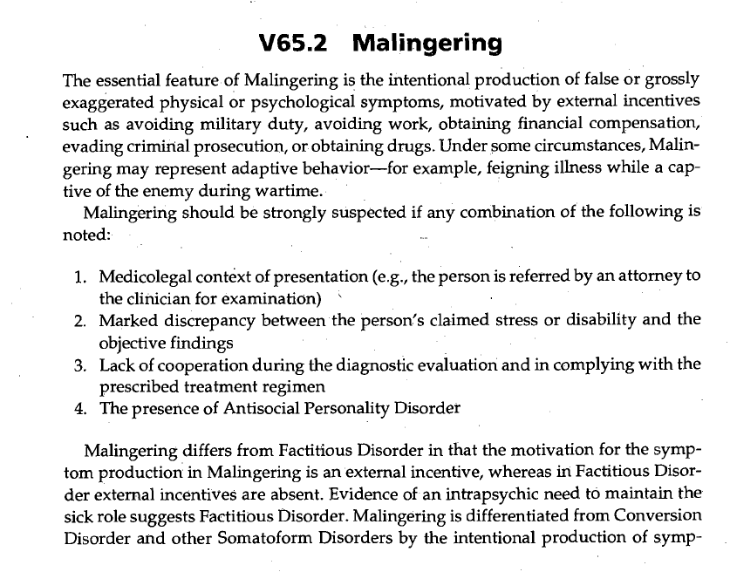

Slide 60
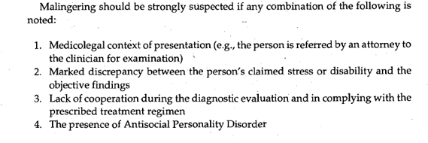

Slide 61
TRIAL #2
Expert Testimony: Defense Experts
Child Abuse
Dr. Kamala London
Qualifications (or lack thereof)
Practice area is research NOT medicine or psychiatry
NEVER provided therapy or treatment in a clinical setting
NEVER conducted a forensic interview
Did NOT review all the materials or talk to witnesses (including the actual child victims)
Financial compensation: $12,000

Slide 62
TRIAL #2
Expert Testimony: State Experts
Child Abuse
Forensic Interviewer: Qualify your CAC forensic Interviewer to testify as an Expert
Child Abuse Counselors: Reach out to your CAC to engage practicing counselors in the area of child abuse

Slide 63
TRIAL #2
Expert Testimony: State Experts
Medical
M B and K B's Pediatrician
Dr. Timothy Kutz: An Expert in Child Abuse from Cardinal Glennon Hospital, St. Louis, MO

Slide 64
TRIAL #2
Closing Arguments
Incorporating your forensic interview into closing arguments
Creating visual aids to assist in proving your case

Slide 65
PEOPLE THE DEFENDANT CONFESSED TO
Melissa Burgund
6. Zach Buttry
2. Mary Buttry
7. Off. Michael Beaber
3. Pastor Mark Church
8. Det. Michael O’Neill
4. Ken Buttry
9. Mark Burgund
5. Clint Albright
10. Donna Burgund

Slide 66
SENTENCING
August 1, 2018 Michael Burgund is again Sentenced to Imprisonment for a Life Sentence

Slide 67
SENTENCING
Victim Impact Statements
Restitution
$82,000 of bond money was awarded to M B and K B Burgund for a lifetime of counseling

Slide 68
Contact Information
Detective Sergeant Michael O’Neill
Alton Police Department
oneill@altonpolice.com
(618)463-3505
First Assistant State’s Attorney Crystal Uhe
Madison County State’s Attorney’s Office
cluhe@co.madison.il.us
(618)692-6280

